Slide 1

Welcome back!
Studio S4
Ma Chi Kin Brian
e1121386@u.nus.edu
Tele: @bmanara

Slide 2
Almost one month of Uni has already passed?!?

Slide 3
Agenda for Today
Admin Matters
Quick Recap
S4 Studio Worksheet
In-class S4 Studio Worksheet
Past RA1 Questions (if time permits)

Slide 4
Admin Matters
Reading Assessment 1 (7 September 2024)
Timings and Venues are out! (Please go to the correct venue and timeslot.)
Don’t be late! You need all the time you can get
Practice Papers available (Discuss any questions in the telegram group/Ed forums!)
Scope: All material up to Week 3 Lectures, Paths, Reflections and Studio S4
Orders of Growth NOT TESTED
Mastery Check 1
No rush, focus on RA1 first!
We will do this after RA1 has passed.
Notes:
Do ask if I missed out on anyone’s missions/quests for grading…
Also, remind those who might be a little lacking in XP, can always catch up with quests. Even partially complete submissions can earn XP!
Recommend doing missions early, so that I can always grade it and you can request for unsubmission to re-attempt

Slide 5
QUICK
RECAP
Nested Constant Declarations
Conditional Statements (if-else)
Higher Order Functions
Scoping

Slide 6
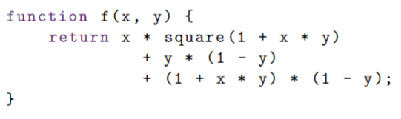
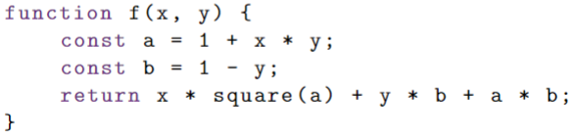
Nested Constant Declarations
Vs
Much more readable!

Slide 7
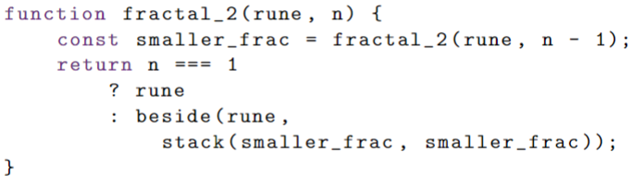
Conditional Statements
We can use if-else now! Wooooooo

Slide 8
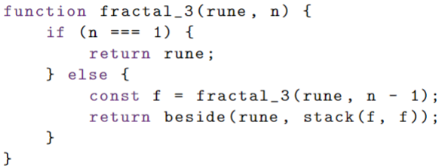
Conditional Statements
Both are equivalent!

Slide 9
Higher Order Functions
Passing functions to functions as arguments
We saw the use of this in repeat_pattern() pre-declared function
We can also declare functions inside our functions!
Lambda Functions used to “simplify” our code
No return, no function keyword used
What’s the syntax for it again?
Notes:
Go through examples in Source Academy!!!

Slide 10
Higher Order Functions
Passing functions to functions as arguments
We saw the use of this in repeat_pattern() pre-declared function
We can also declare functions inside our functions!
Lambda Functions used to “simplify” our code
No return, no function keyword used
parameter => expression
(parameters) => expression
Return functions from functions!
Notes:
Go through examples in Source Academy!!!

Slide 11
Scope of Names
Types of Declarations:

Slide 12
Scope of Names
Types of Declarations:
Pre-declared Names (math_floor, math_E etc.)
Constant Declarations (const …)
Parameters
Function name
Name occurrence always refers to the closest surrounding name declaration
Let’s go through some examples…

Slide 13
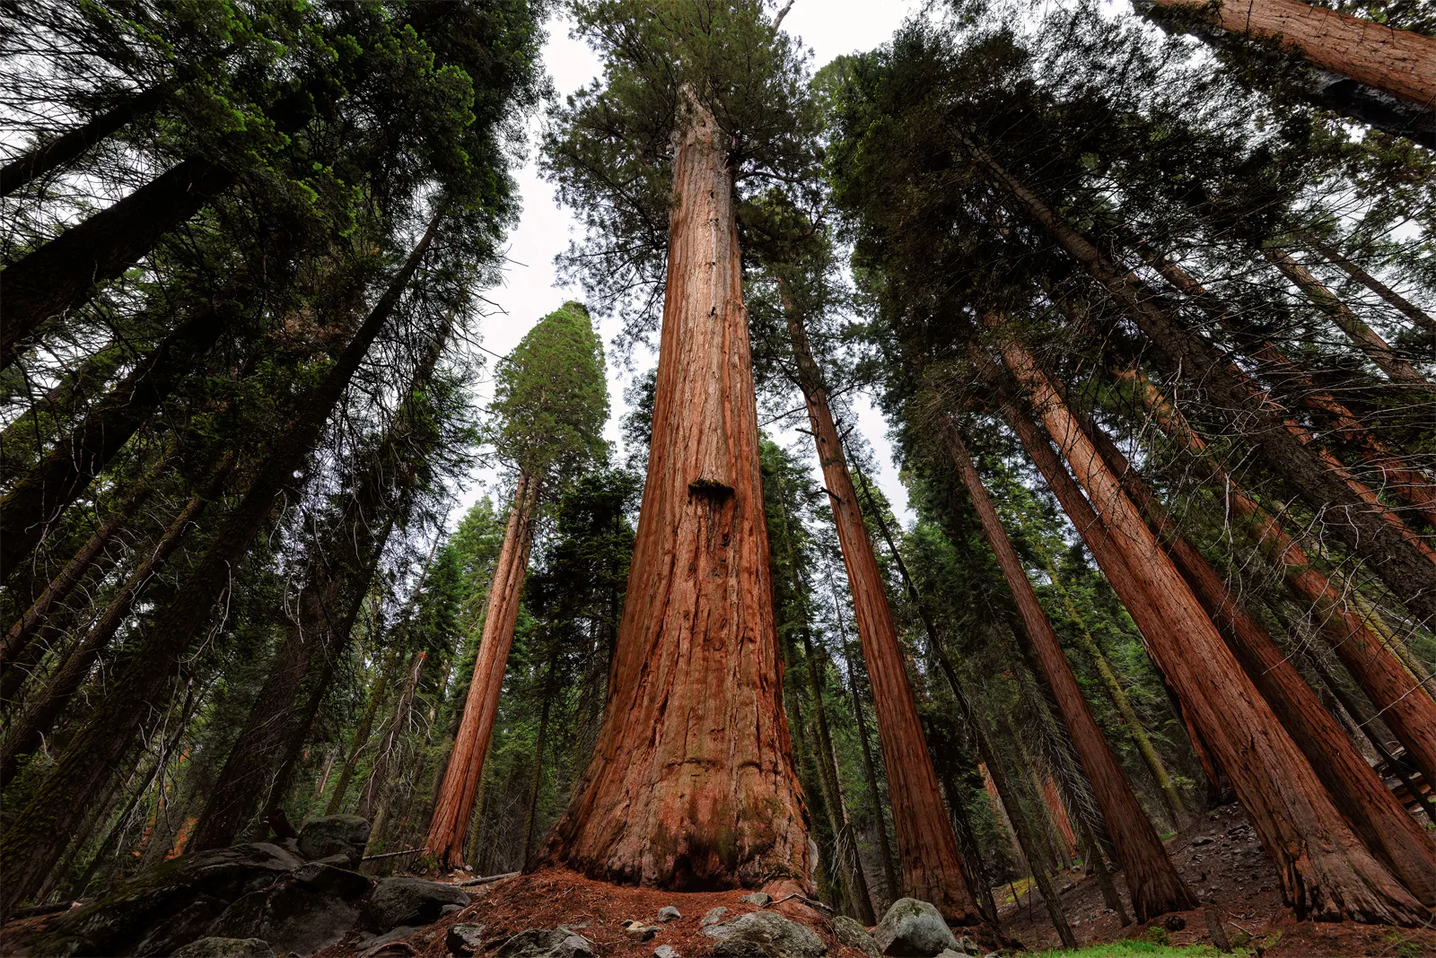
Tree Recursion
S4 Studio Sheet

Slide 14
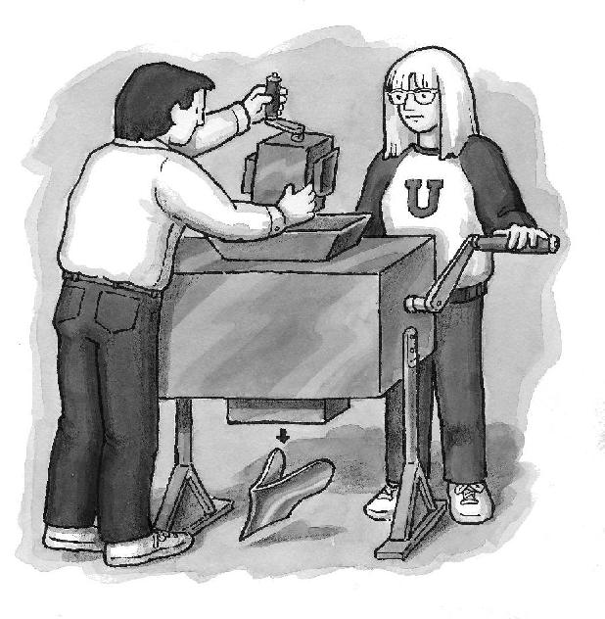
Higher-Order Functions
S4 In-class Studio Sheet

Slide 15
Some Past RA1 Questions…

Slide 16
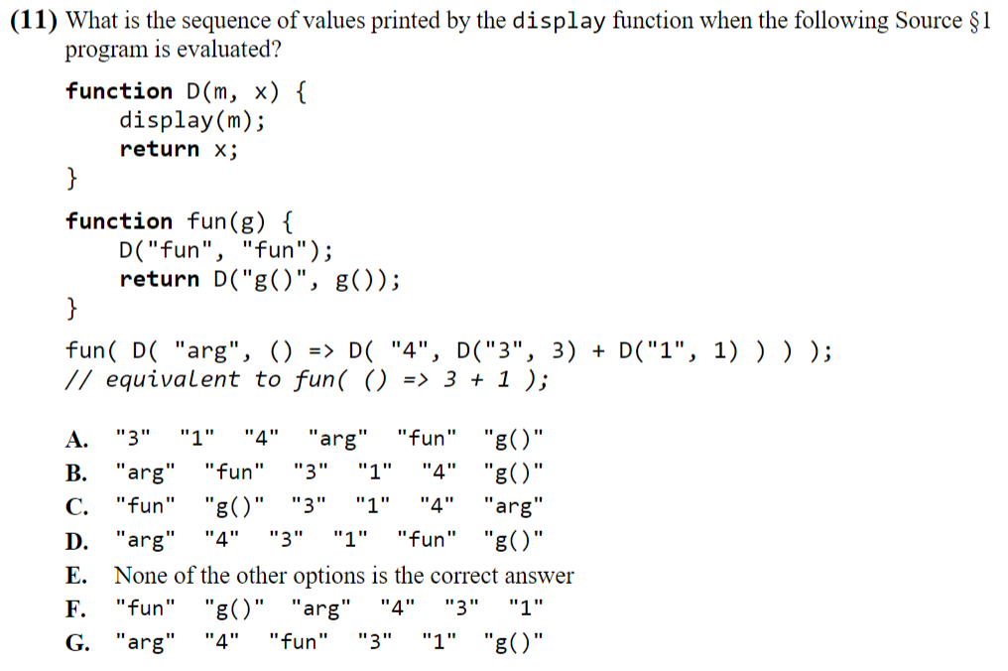
AY23/24 Sem 1
Q11

Slide 17
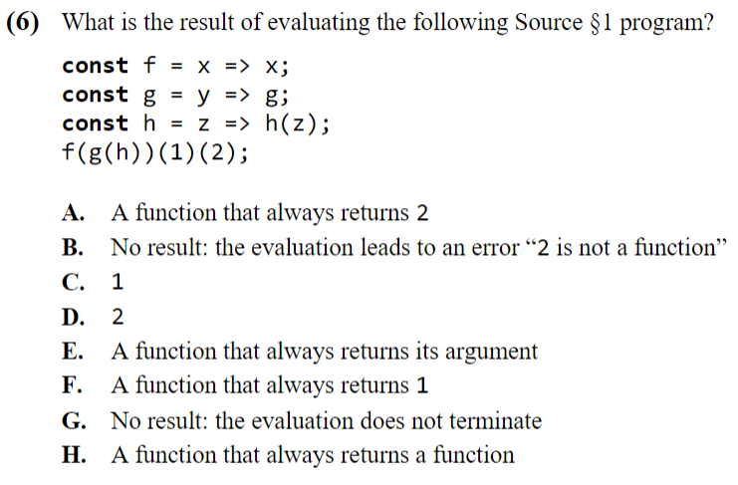
AY23/24 Sem 1
Q6

Slide 18
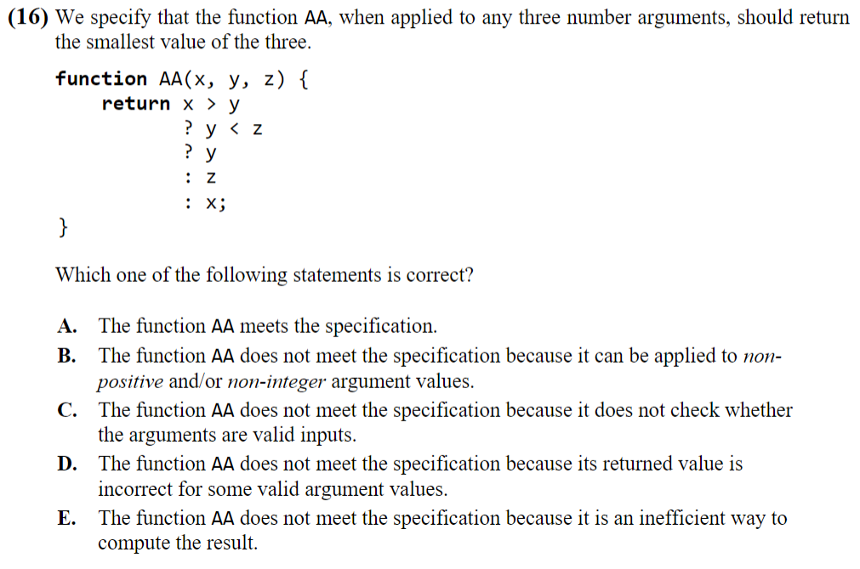
AY23/24 Sem 1
Q16

Slide 19
Good Luck for your RA1!
Slides will be uploaded to the google drive.

